Slide 1
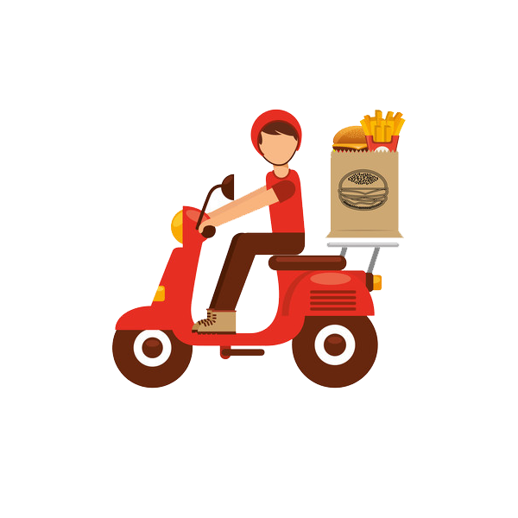
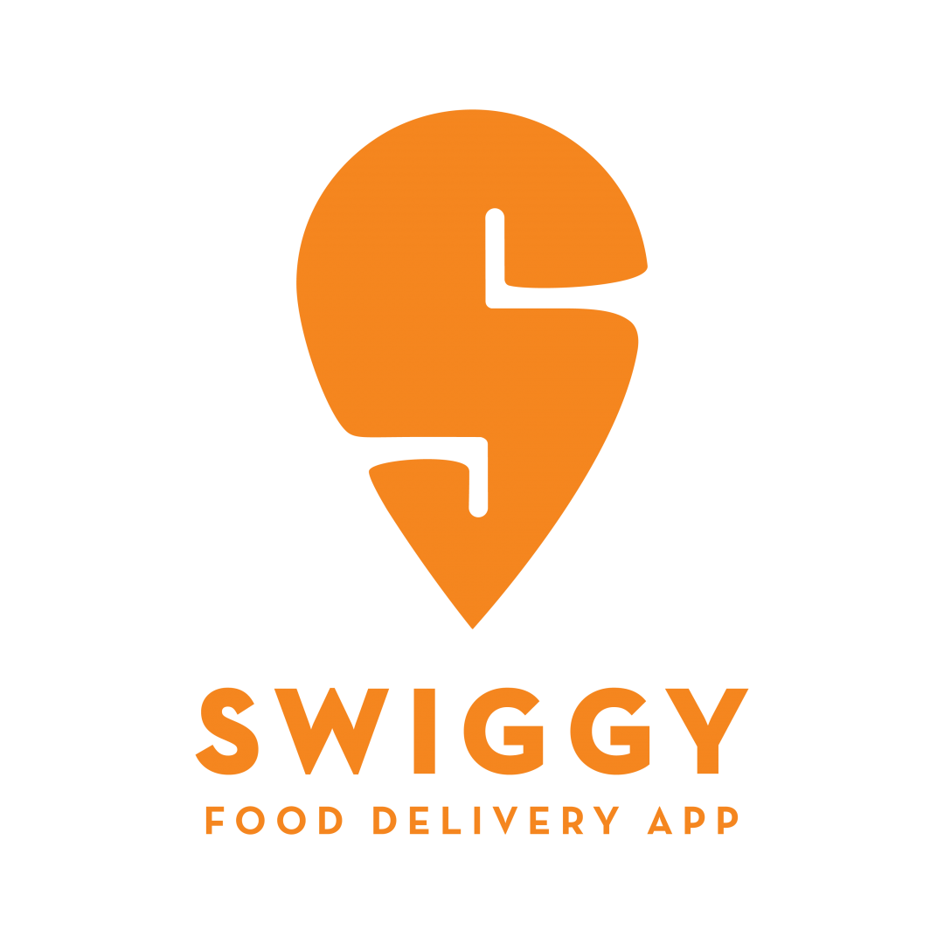
Find the best location for cloud kitchen for client in Banglore
Swiggy restaurant's Data analysis

Slide 2
Objectives
Find the best location for cloud kitchen for client in Bangalore
Suggest top selling dishes in region

Slide 3
Objectives
Find the best location for cloud kitchen for client in Bangalore
Suggest top selling dishes in region
Suggest Competitive pricing for dishes

Slide 4
Objectives
Scrape Data from Swiggy website
Find the best location for cloud kitchen for client in Banaglore
Suggest top selling dishes in region
Suggest Competitive pricing for dishes

Slide 5
procedure
Scrape Data from Swiggy website
Data cleaning

Slide 6
procedure
Scrape Data from Swiggy website
Data cleaning
Analysing Data

Slide 7
procedure
Scrape Data from Swiggy website
Data cleaning
Analysing Data
Creating Dashboard

Slide 8
procedure
Scrape Data from Swiggy website
Data cleaning
Analysing Data
Creating Dashboard

Slide 9
Data scraping and cleaning

Slide 10
Data scraping and cleaning
Beautiful Soup library

Slide 11
Data scraping and cleaning
Beautiful Soup for scraping
Pandas for Data Cleaning

Slide 12
Analysing Data

Slide 13
Analysing Data
Excel for analyzing data

Slide 14
Area-wise distribution of restaurant
Koramangala has highest no. of restaurants
that is 126 in total
Dodakattappa has only 1 restaurants

Slide 15
1000+ delivery reviews
Koramangala has maximum number of restauraunts with 1000+ delivery reviews
Jayanagar comes second with 586 reviews

Slide 16
Area with lowest reviews for food
Indiranagar has highest number of restaurants with low rating followed by Vasanth Nagar and Koramangala

Slide 17
Most expensive food
Biryani is most expensive food on average costing 350 rs per person

Slide 18
Number of restaurants serving the cuisines
Chinese is being served by highest number of restaurants followed by north Indian food

Slide 19
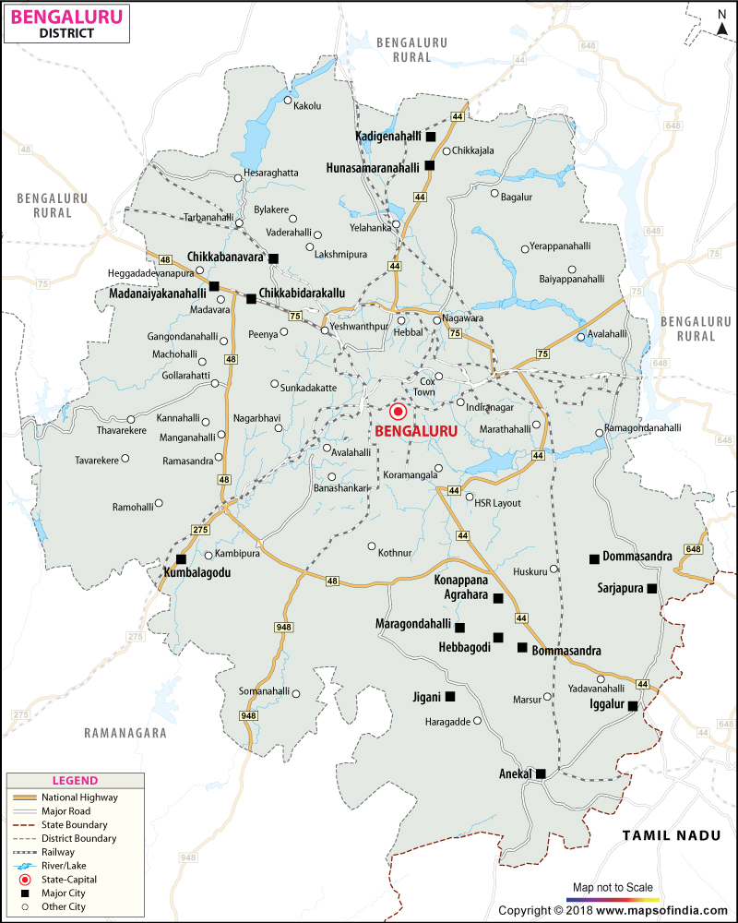
Conclusion
Koramangala ,J.P Road, ashok nagar would
be ideal Place to start cloud kitchen
The cuisine category should be Chinese,
Dish price
chicken fried rice 190Rs
gobi manchurian 170 Rs
chilli chicken 200 Rs
veg fried rice 150 Rs
paneer roll 100 Rs

Slide 20
Future scope of cloud kitchen
To break into market we suggested most popular cuisine with competitive
pricing
As the popularity of our cloud kitchen increases we can move further
Into other niche cuisine

Slide 21
Thank you

